Slide 1

Deep Learning Explicit Differentiable Predictive Control Laws for Buildings
IFAC NMPC July 11-14, 2021
Ján Drgoňa
Collaborators: Aaron Tuor, Elliott Skomski,
Soumya Vasisht, Draguna Vrabie

Slide 2
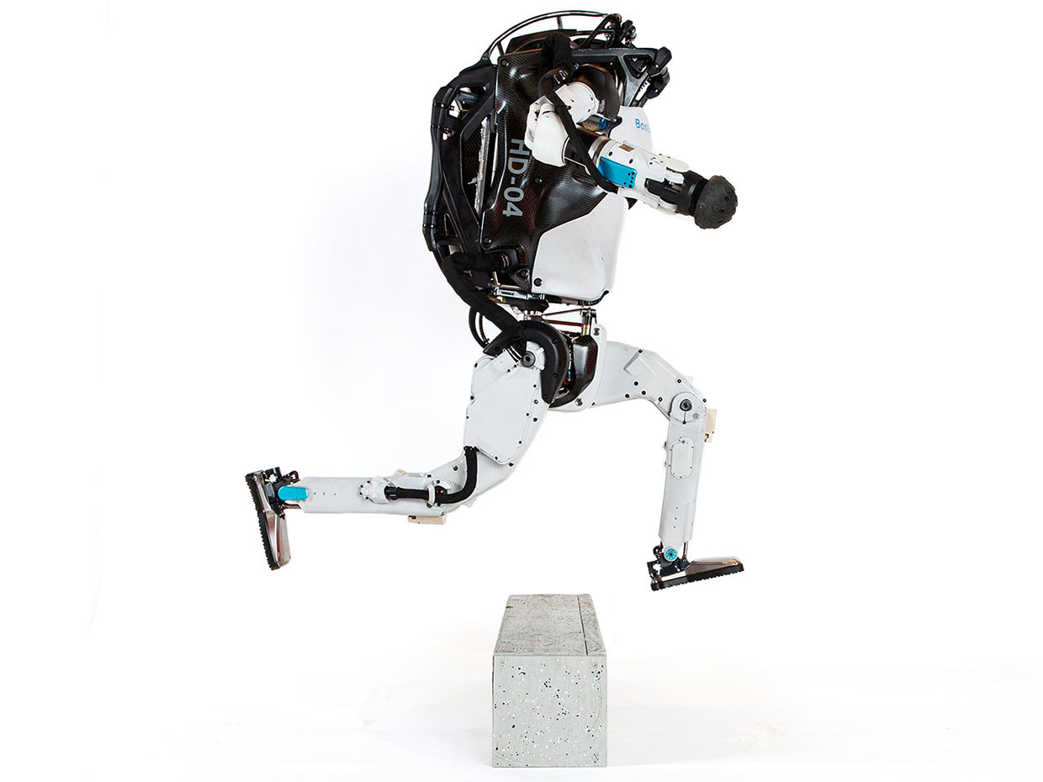


Model Predictive Control
Successes
Challenges
95% of the process control applications are PID loops using trial and error rule-based optimization. The rest is model predictive control (MPC).
Modeling
Unknown or partially known dynamics
Physics-based modeling is expensive
Purely data-driven models lack generalization
Real-time optimization
Scalability
Computational limitations of control hardware
Parallelization, distributed optimization
Assumption:
Reliable and accurate system dynamics model
Drgona J., J. Arroyo, I.C. Figueroa, D. Blum, K. Arendt, D. Kim, and E.P. Olle, J. Oravec, M. Wetter, D. L. Vrabie, L. Helsen. 2020. "All You Need to Know About Model Predictive Control for Buildings." Annual Reviews in Control, September 29, 2020
Notes:
Domain awareness, trusted autonomy
PID controller-
A PID controller continuously calculates an error value
the difference between a desired setpoint (SP) a process variable (PV) and
Correction based on proportion of error, integration of accumulated error, and derivative of the error
MPC first developed in the chemical industry to address some of the shortcomings of a PID controller.
Designed to handle MIMO systems
Can handle constraints
Preview capability
MPC uses a model to predict future outcomes of a process.
Online optimization problem at each process interval. Performs first action in the rollout.
requiring large memory and fast processor to operate in real time.
Training and calibration of models- lots of expert time
Optimization: translation to a solver language- lots of expert time
Computational limitations of control hardware depending on the system

Slide 3
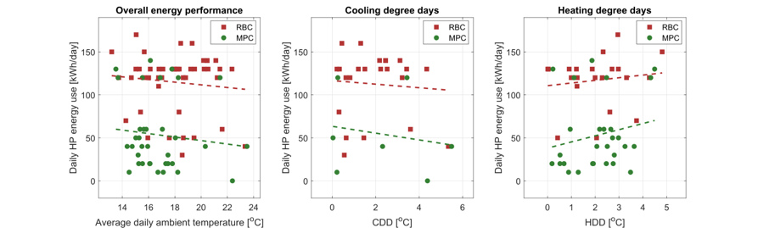
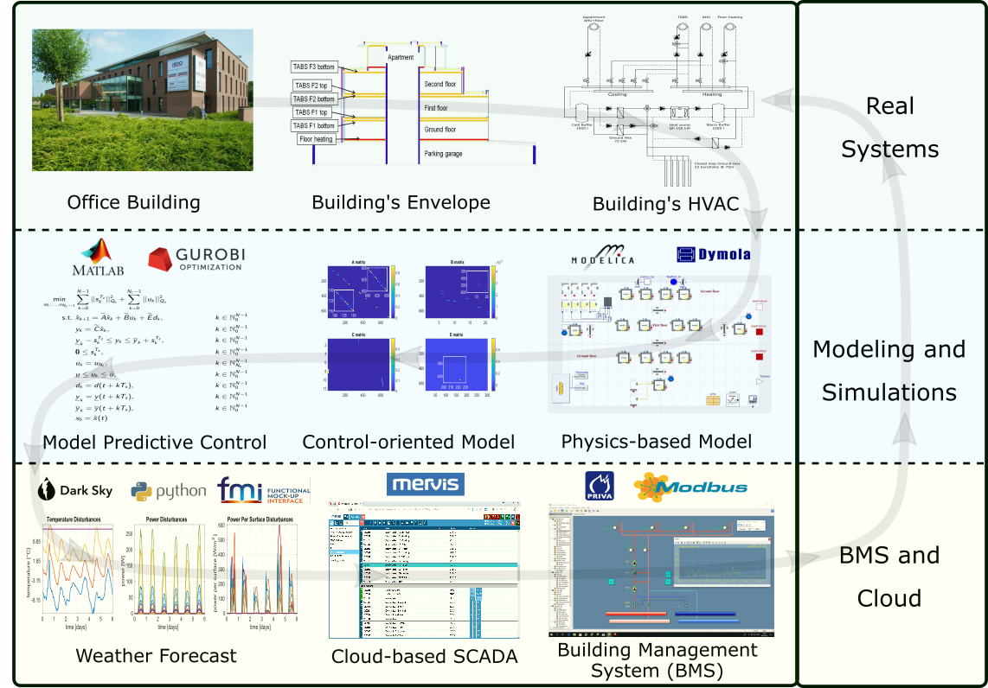
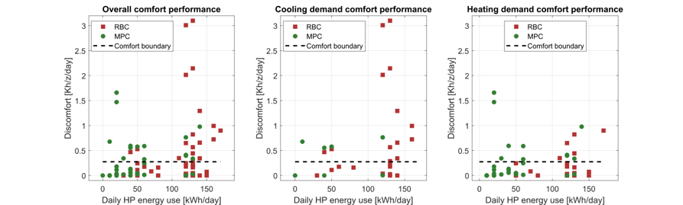

Implementation of MPC in Office Building in Belgium
The field test energy use performance of MPC (green) and RBC (red) during the transient season. Each dot represents one day.
The field test thermal comfort performance of MPC (green) and RBC (red) during the transient season. Each dot represents one day.
Highlights: Heat pump energy savings up to 53%.
Thermal comfort improvement up to 37%.
Drgona J., et al., Cloud-based implementation of white-box model predictive control for a GEOTABS office building: a field test demonstration. Journal of Process Control, 2020.
Notes:
To better understand the complexity of the task, lets walk through a complete workflow as implemented for a practical use case to control an office building in Belgium.
This office building is equipped with thermally activated building structures with a geothermal heat pump (GEOTABS). These kinds of buildings are known to be very challenging to control due to the large thermal mass and associated time delays. For optimal operation of this type of systems, predictive control is an absolute must.
First one develops a high-fidelity physics-based model based on the available engineering documentation and measurement data.
Then the control-relevant equations are extracted and used to construct an optimization-based predictive controller.
The optimized controls are computed every 15min based on new weather forecast and new measurement from the building, then the controls are communicated to the building management system for execution.
The whole procedure takes approximately a minute to execute in real time.
After using the MPC in the office building for a couple of months the team measured more than 50% energy savings on the heat pump and improved thermal comfort by approximately 37%. The rigid and delayed behavior of the rule-based controller is replaced by dynamic and anticipatory behavior of MPC, which keeps the zone temperatures closer within comfort bounds and delivers cooling only when it is needed.

Slide 4
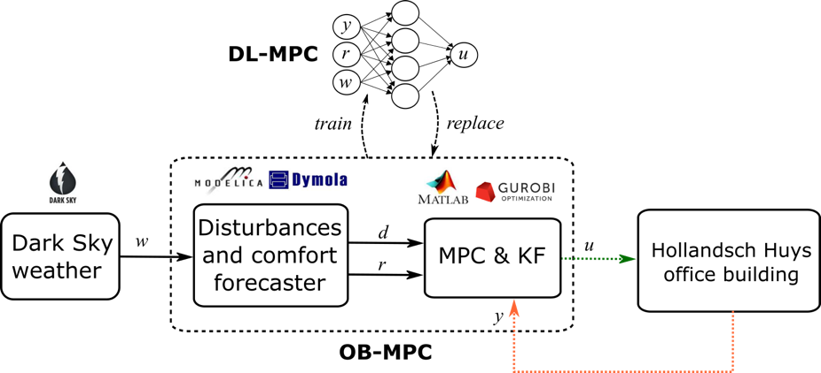
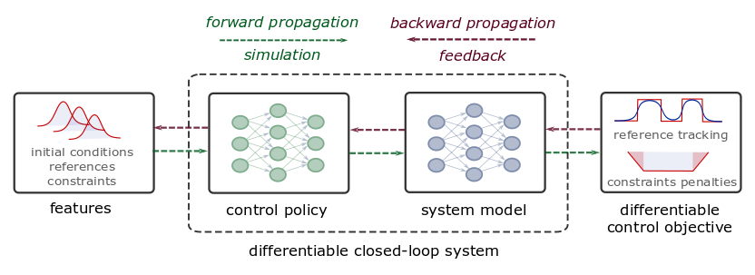
Deep Learning of MPC-based Control Policies
Approximate MPC
Supervised learning
Imitation learning of MPC
Requires original MPC and model
Differentiable Predictive Control
Differentiable closed-loop model
Model-based policy optimization
Theoretical connection with MPC
Drgona J., et al., “Approximate model predictive building control via machine learning,” Applied Energy, 2018
Drgona J., Helsen L., Vrabie D., "Cutting the Deployment Costs of Physics-Based MPC in Buildings by Simulation-Based Imitation Learning.”, proceedings of Dynamic Systems and Control Conference 2020, - Best paper award
Drgona J., et al., Differentiable Predictive Control: An MPC Alternative for Unknown Nonlinear Systems using Constrained Deep Learning, preprint 2021. https://arxiv.org/abs/2011.03699

Slide 5

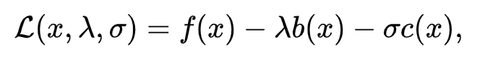
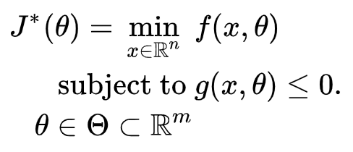

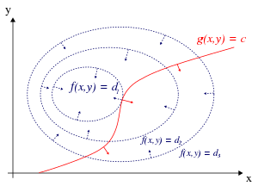
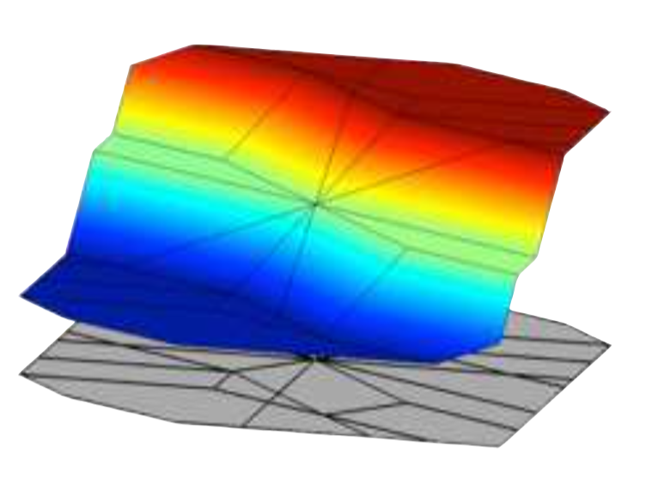


Formulations of Constrained Optimization Problems
Standard form
Lagrangian form
Parametric programming
Machine learning
“online” optimization
Single solution for
given parameter values
“online” optimization
Using soft constraints
Instead of hard constraints
“offline” optimization
Obtains a solution map
for a set of parameters
“offline” optimization
Obtains a model (map)
for a set of datapoints
Data-driven differentiable parametric optimization (D3PO): Combining principles of
Lagrangian formulation, parametric programming and ML
Notes:
There are four main challenges that must be overcome to make MPC cost-effective
The Training and calibration of models – must be automated
The translation of the optimization problems to a solver language – must be automated
To address the computational limitations of embedded hardware - must reduce computing need without trading performance
Acceptance by building operators – complex decisions must be translated to interpretable decision rules

Slide 6
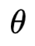
Data-Driven Differentiable Parametric Optimization (D3PO)
D3PO problem definition:
D3PO implementation using Neuromancer:
import neuromancer as nm dataset = nm.datasets.Dataset(sequences=data)
components = nm.policies.SolutionMap(**kwargs) objectives = nm.Objective(torch.norm(z, 2)), weight=Q_x) constraints = nm.Objective(torch.norm(F.relu(
torch.mm(A, z.T)-b), 1), weight=Q_con) problem = nm.Problem(objectives, constraints, components)
optimizer = torch.optim.AdamW(model.parameters(), lr)
trainer = nm.Trainer(problem, dataset, optimizer, epochs) best_model = trainer.train()
Optimize x, given dataset
by finding a mapping x=h( )
PyTorch-based D3PO framework:
https://github.com/pnnl/neuromancer

Slide 7
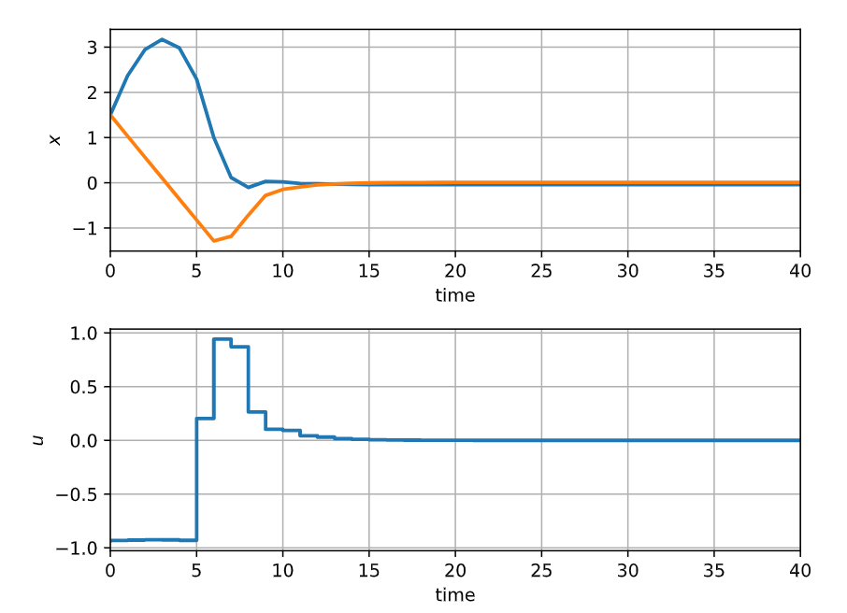
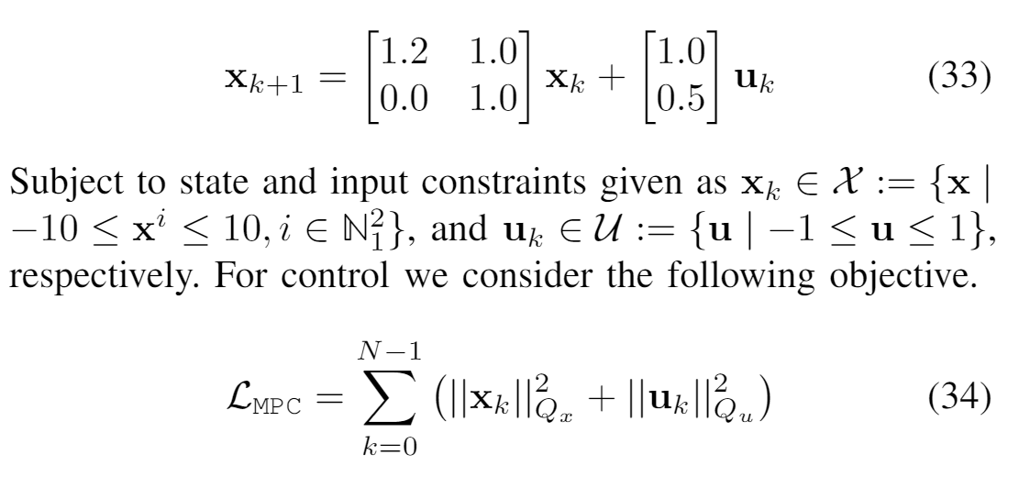
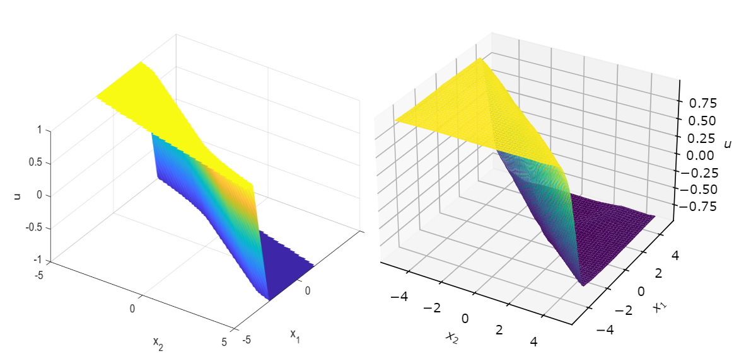
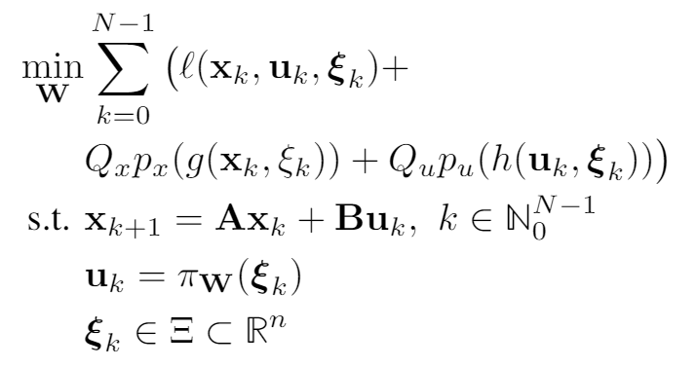
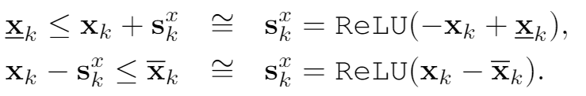
Learning to Stabilize Known Unstable System with DPC
Problem setup:
DPC formulation:
Drgona J., Tuor A., Vrabie D., Learning Stable Adaptive Explicit Differentiable Predictive Control for Unknown Linear Systems, under review, 2021

Slide 8

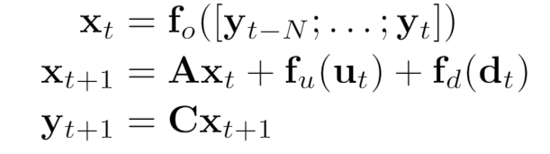
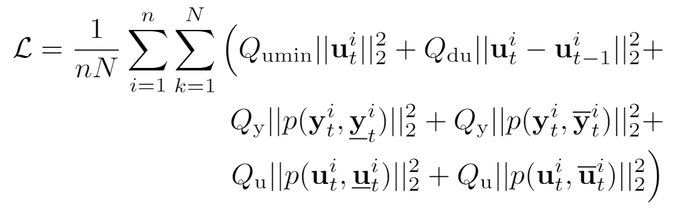
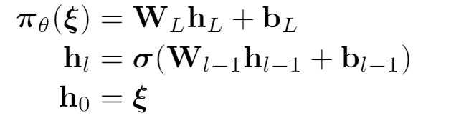
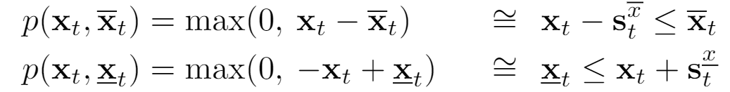
Economic DPC for Building Control
System model
Economic MPC loss function with penalties
Explicit control policy

Slide 9
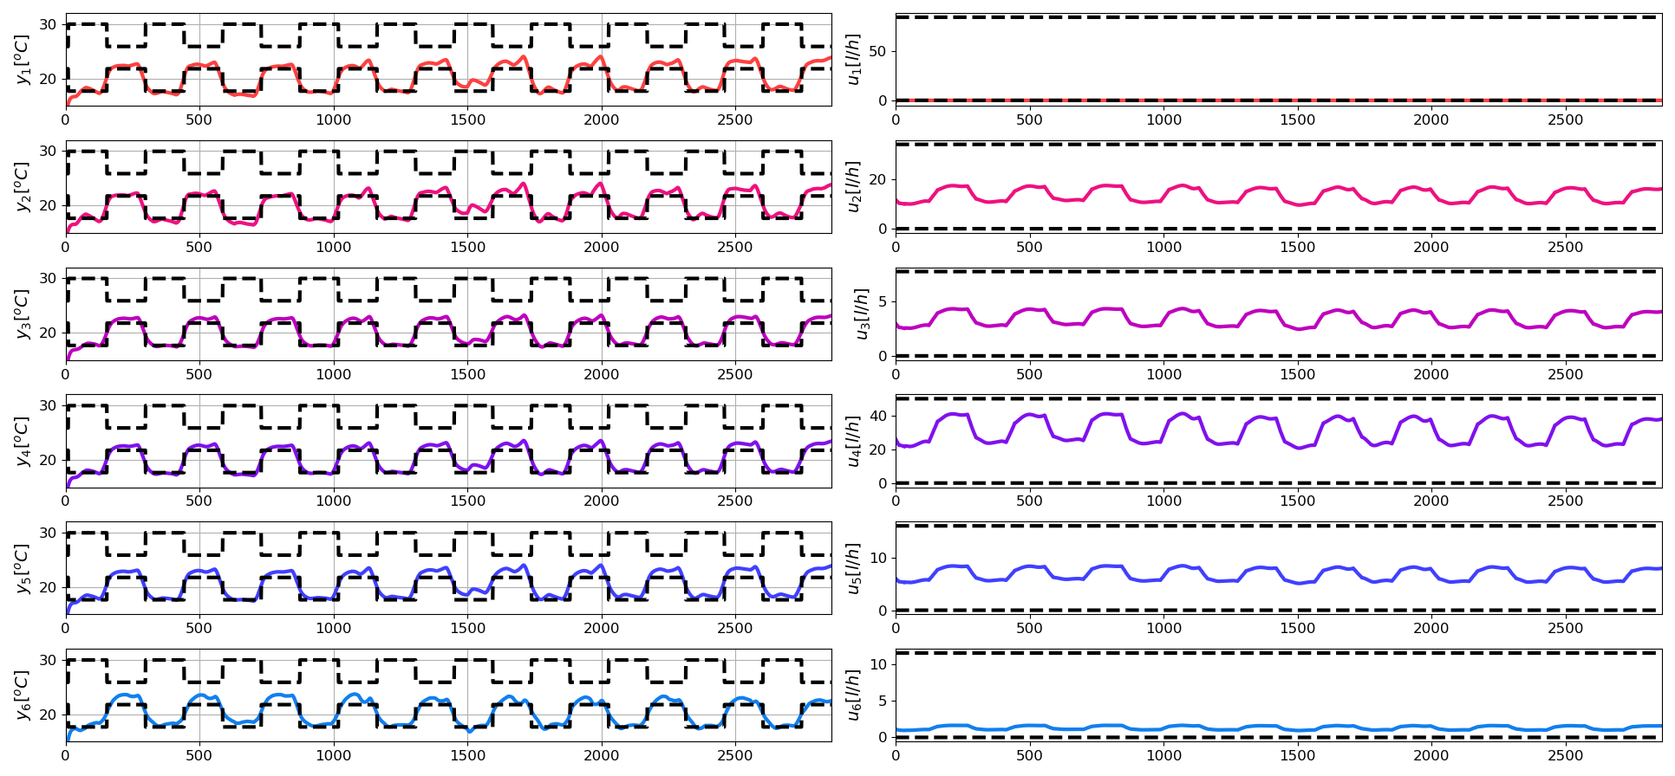
Closed-loop Performance of DPC on Learned Model without Plant-Model Mismatch

Slide 10
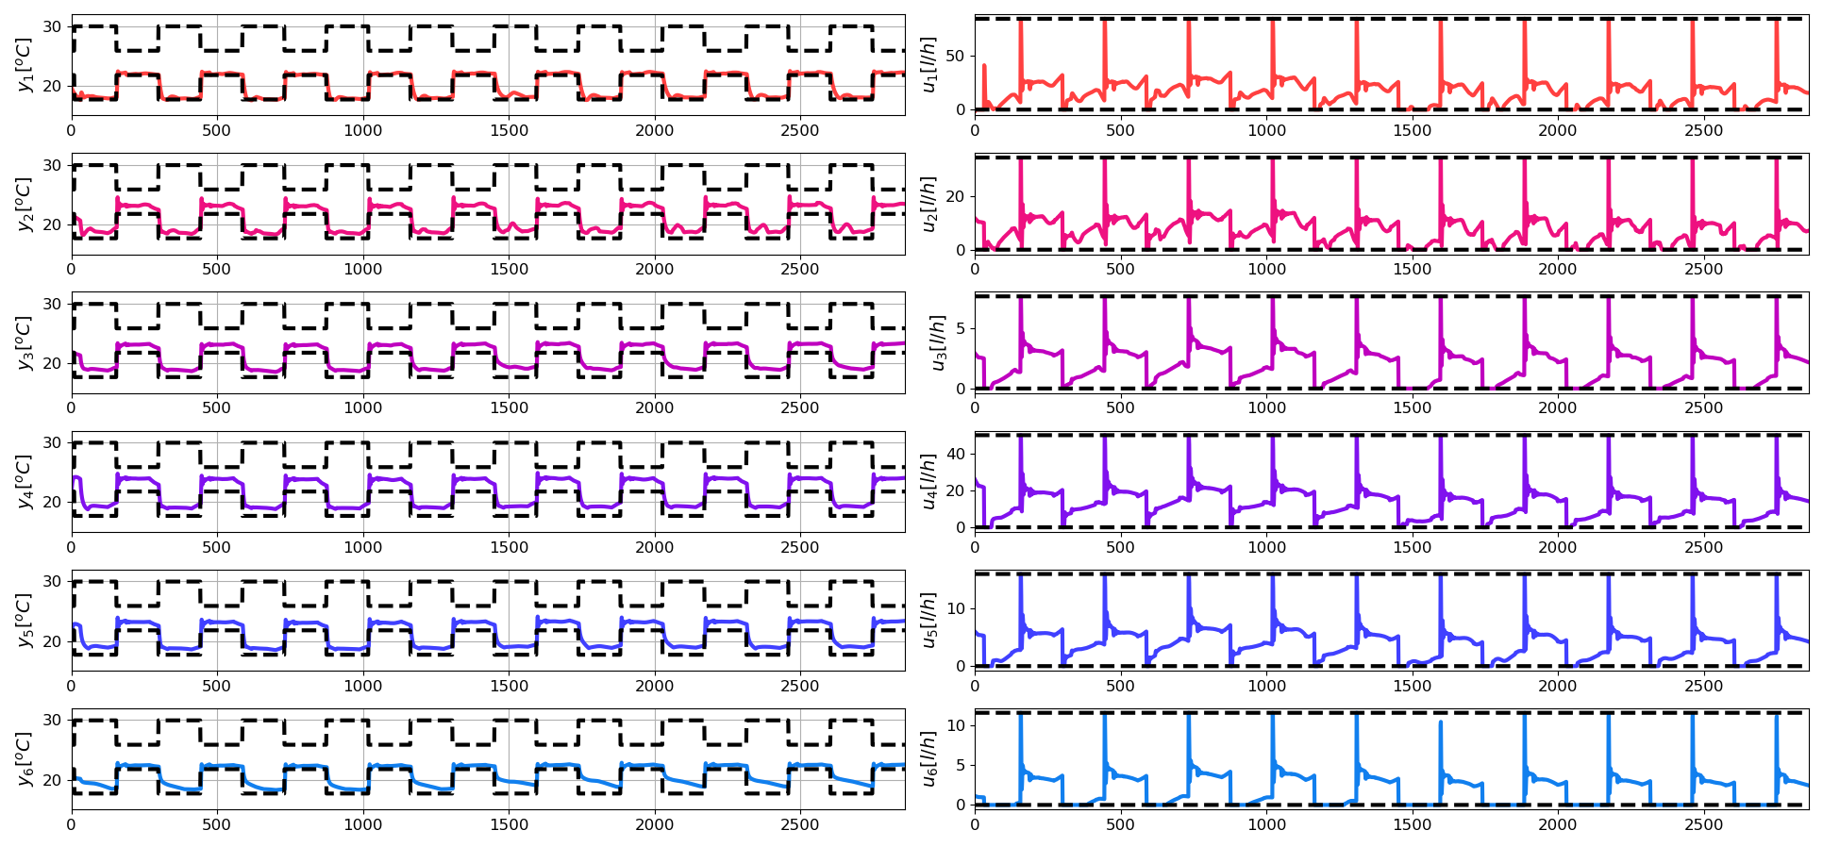
Closed-loop Performance of DPC on System Model with Plant-Model Mismatch and PI Correctors

Slide 11
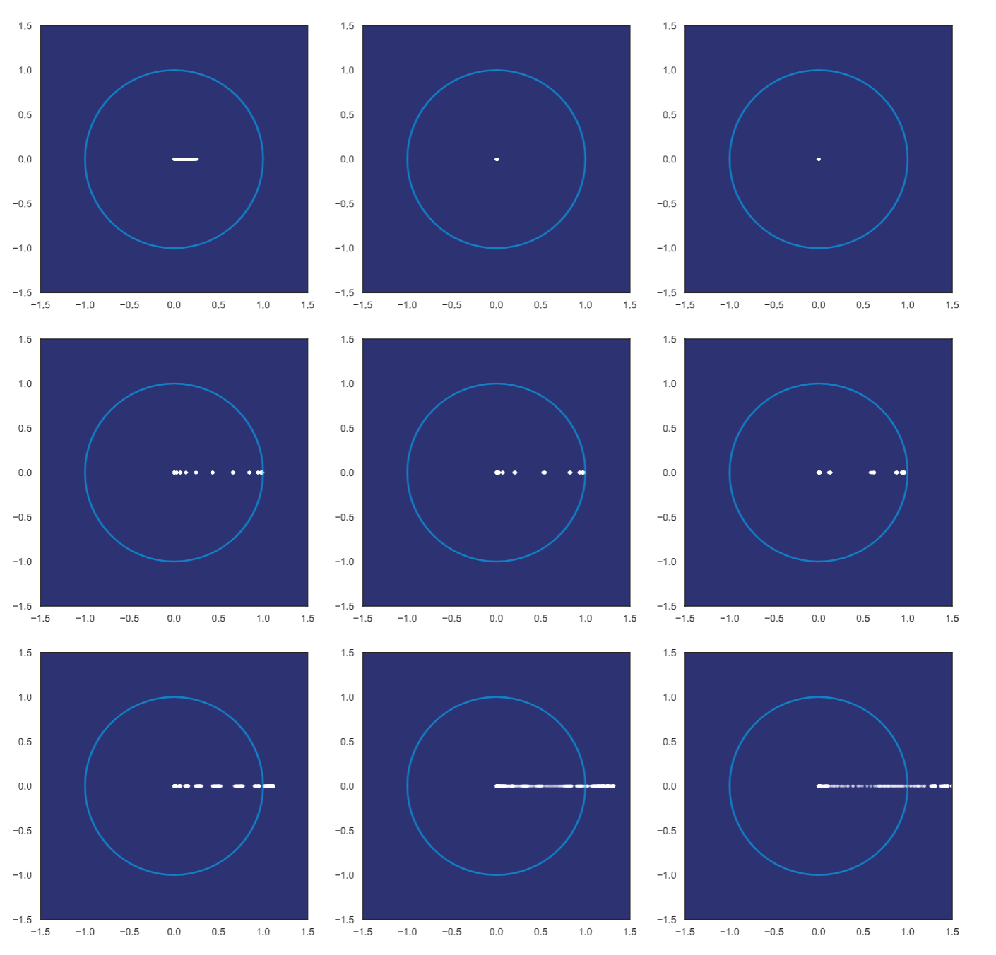
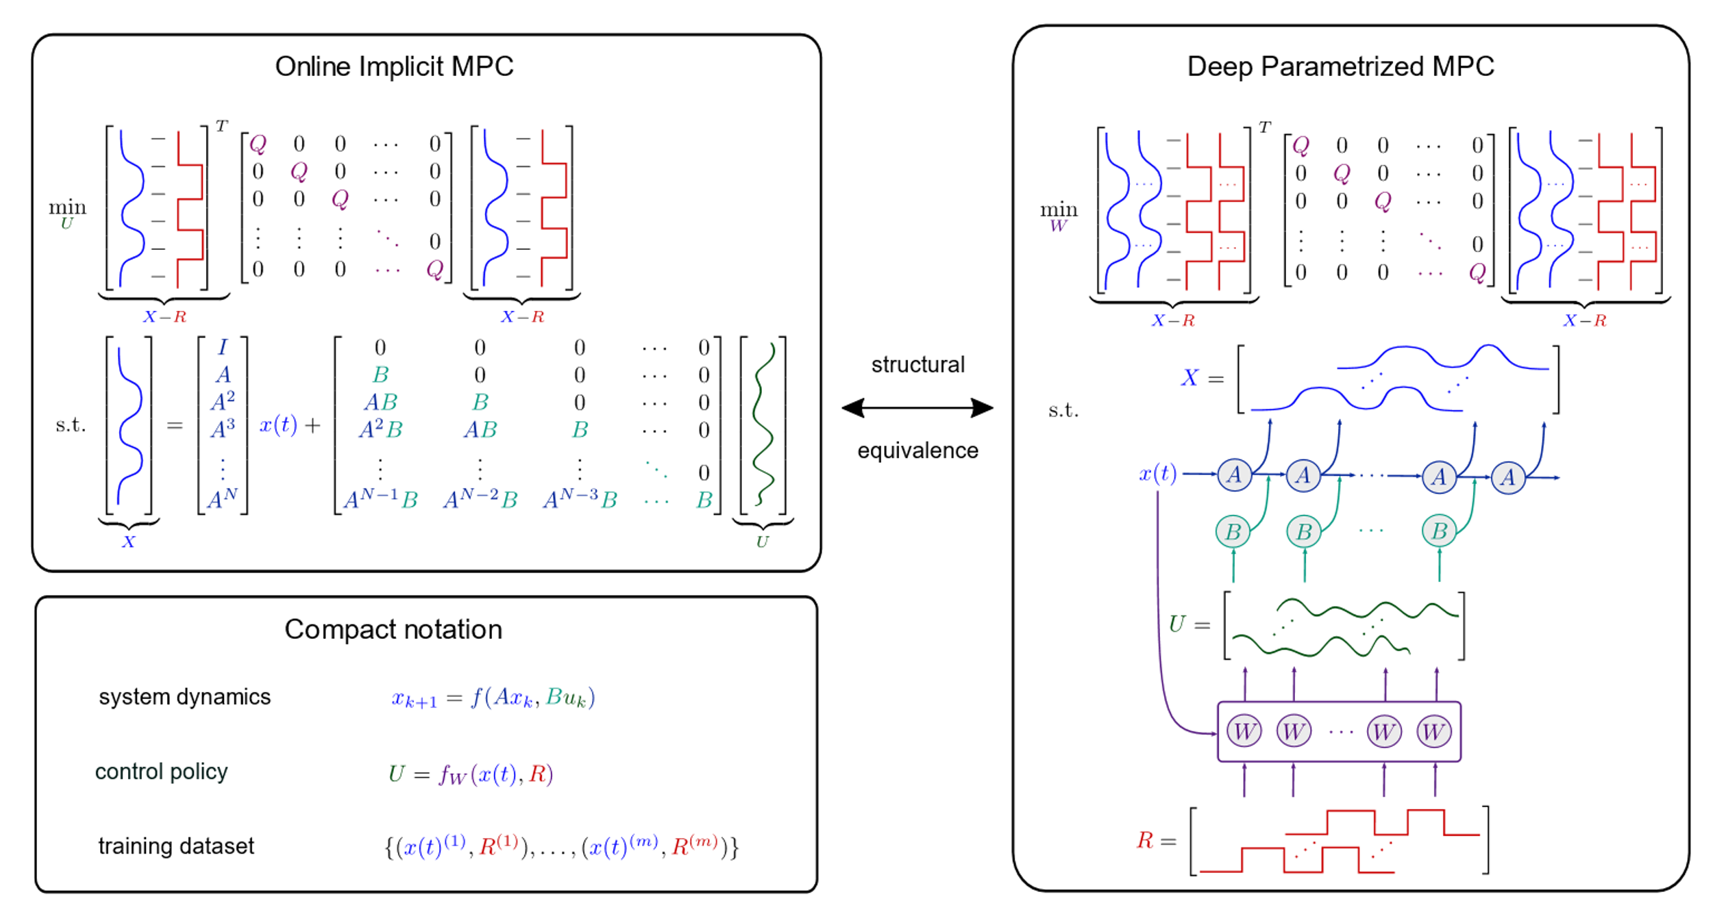
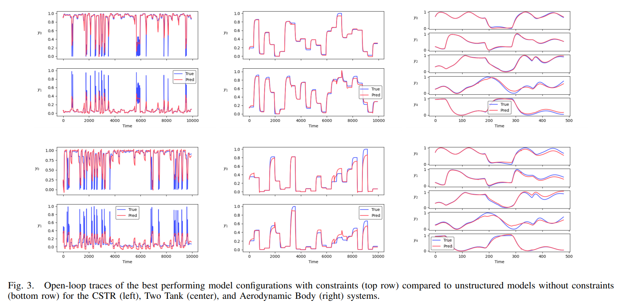
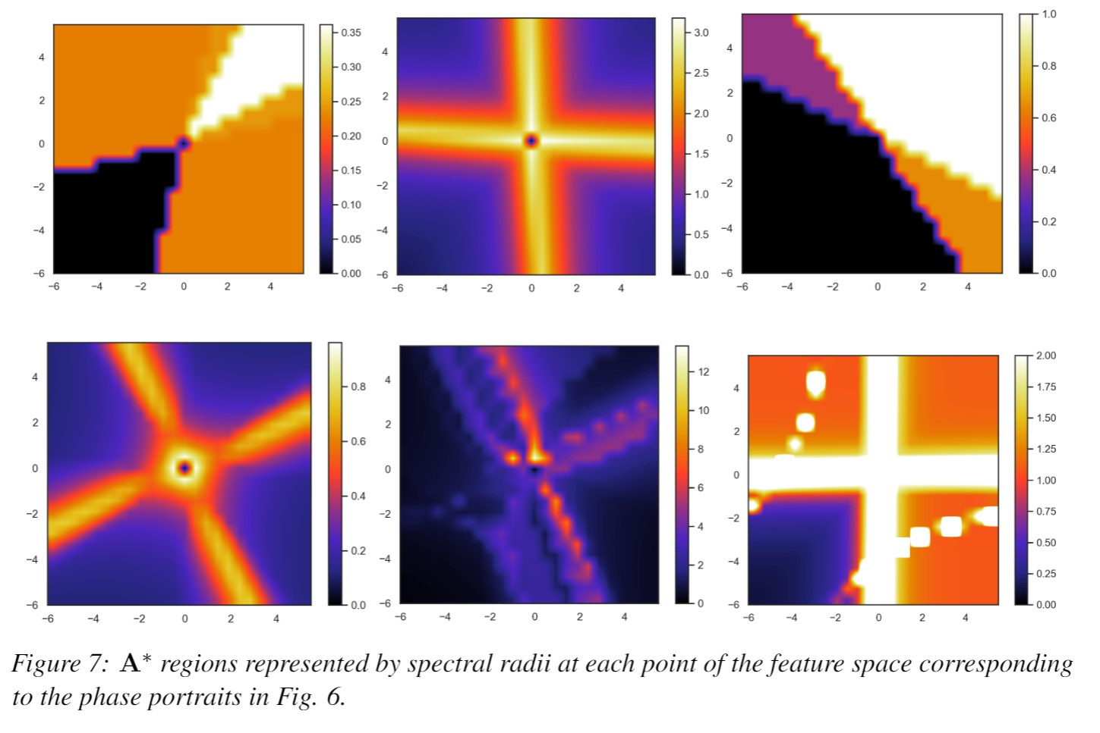
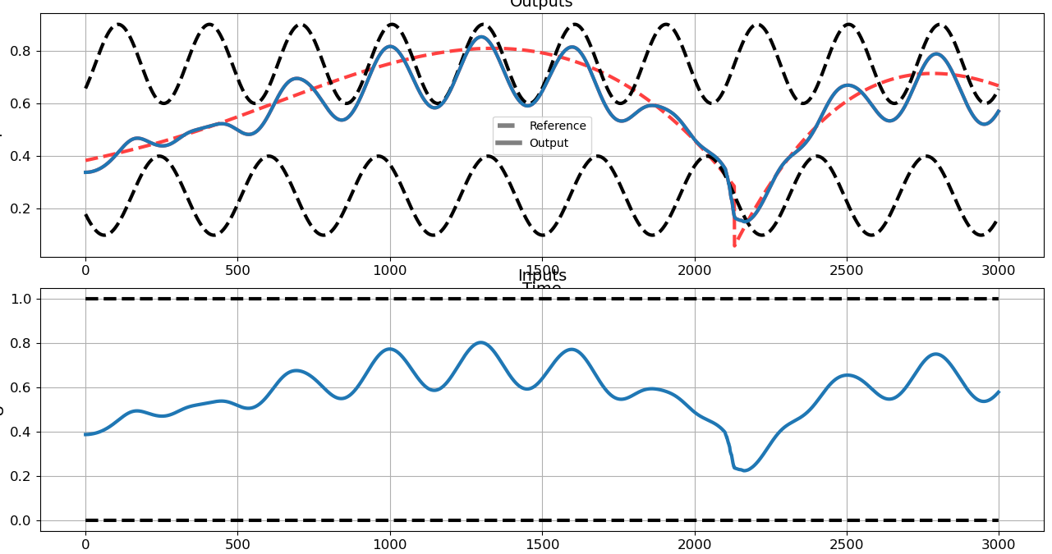
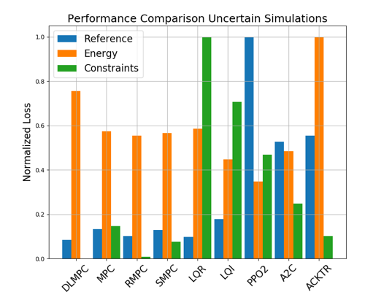
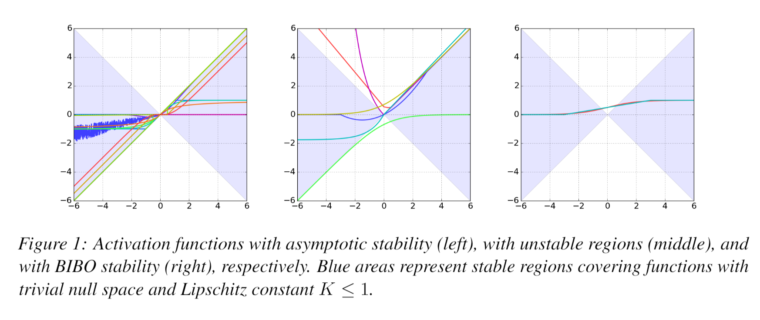
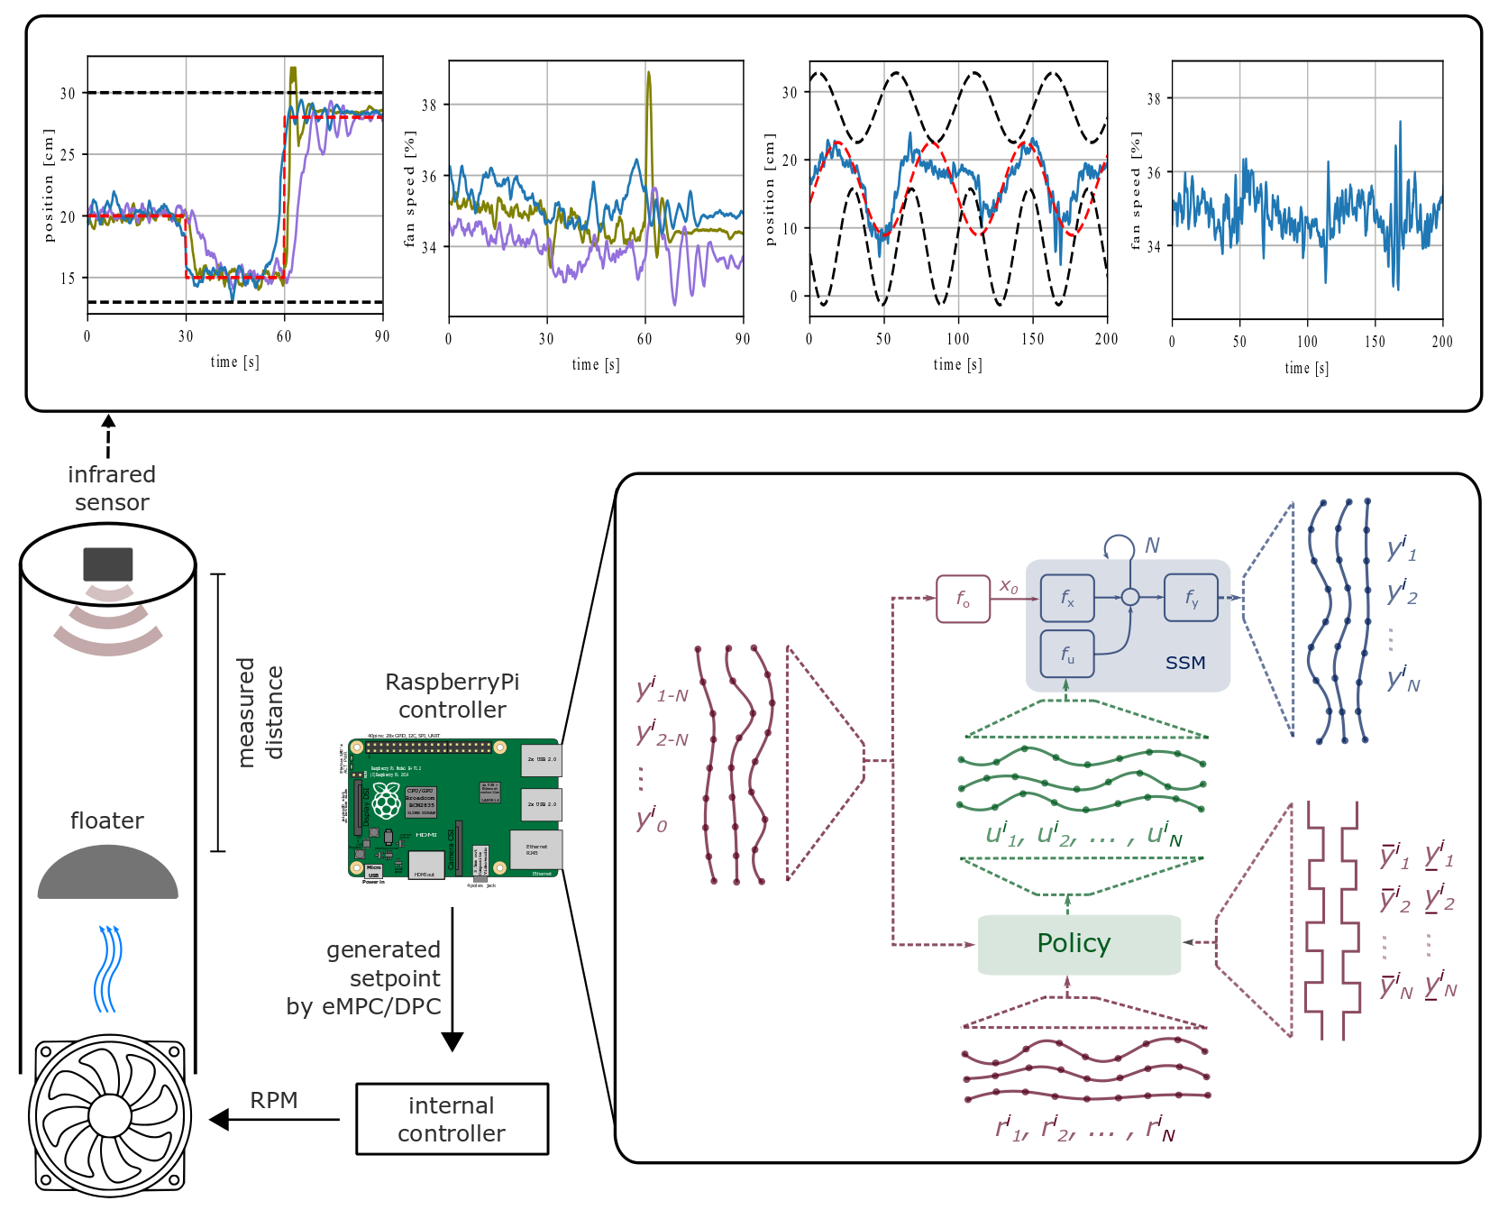
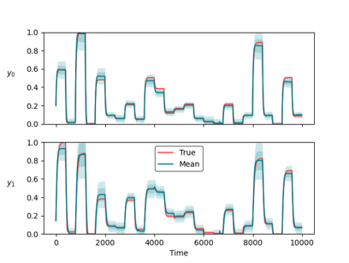
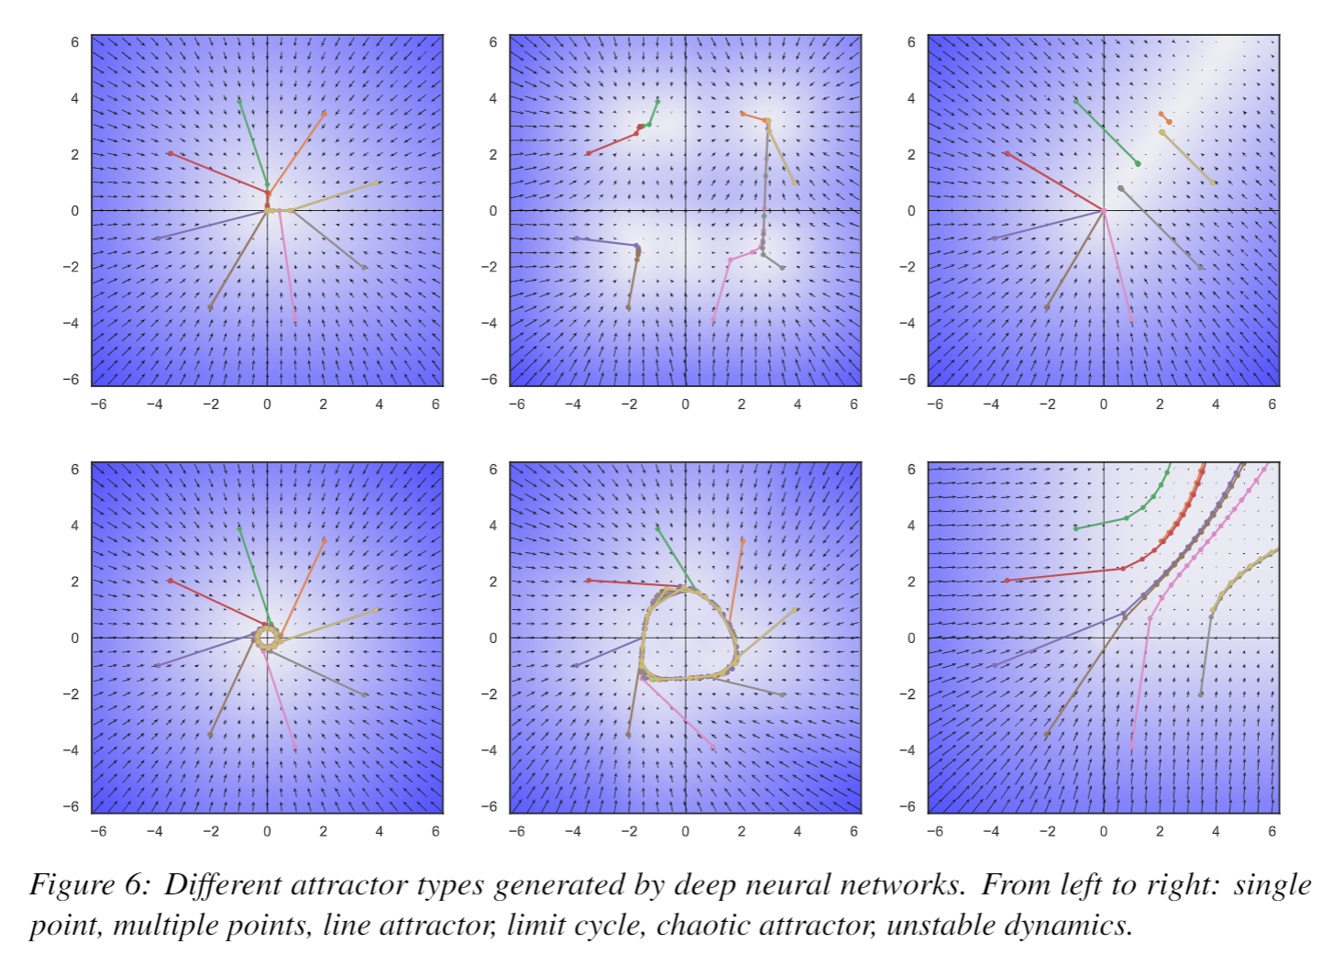
Conclusion
Differentiable Predictive Control
Neural state space models
Incorporating constraints
Explicit neural control policies
Theoretical connection with MPC
Ongoing work
Uncertainty Quantification
Plant-model mismatch
Theoretical guarantees: convergence, stability, constraints satisfaction
Code development
Neuromancer software package
https://github.com/pnnl/neuromancer
Structured linear maps in Pytorch
https://pnnl.github.io/slim/
Long-Term Vision
Causal discovery, dynamical coupling
Solving large-scale non-convex constrained optimization problems
Applications in energy, manufacturing, cyber

Slide 12
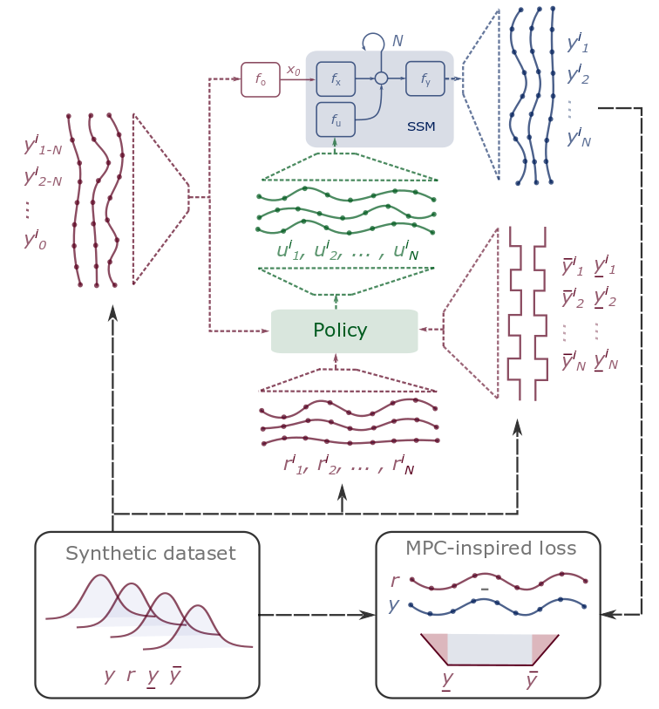
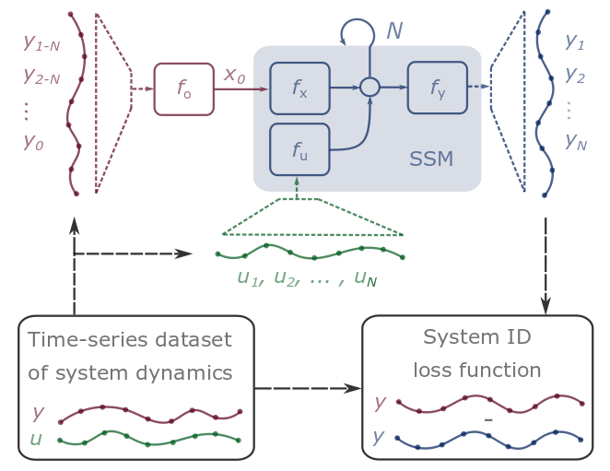
Differentiable Predictive Control (DPC)
Stage I: System Identification
Stage II: Policy Optimization
[1] Jan Drgona, et al., Differentiable Predictive Control: An MPC Alternative for Unknown Nonlinear Systems using Constrained Deep Learning, preprint 2021
[2] Jan Drgona, Aaron Tuor, Draguna Vrabie, Learning Stable Adaptive Explicit Differentiable Predictive Control for Unknown Linear Systems, under review, 2021

Slide 13
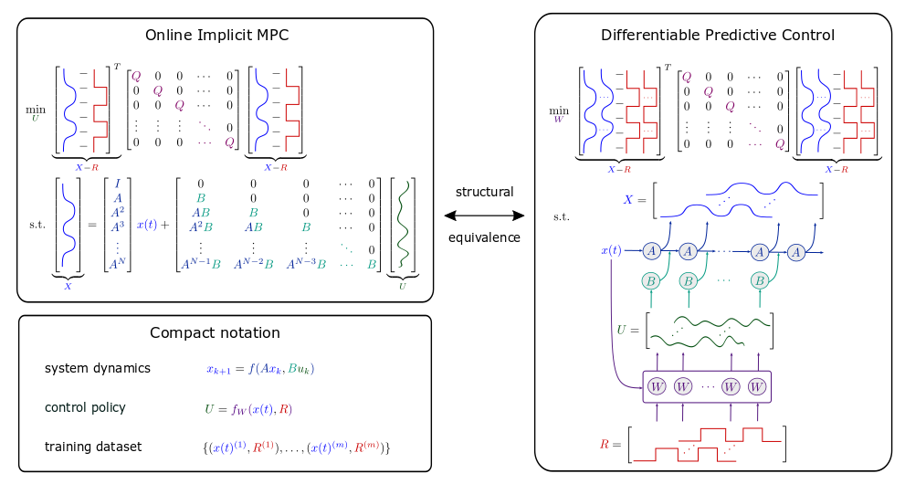
Model Predictive Control vs Differentiable Predictive Control
DPC = Formulation of MPC problem as a constrained deep learning problem
Drgona J., Tuor A., Vrabie D., Learning Stable Adaptive Explicit Differentiable Predictive Control for Unknown Linear Systems, under review, 2021

Slide 14
Modeling Thermal Dynamics
Ján Drgona, et al., Physics-constrained deep learning of multi-zone building thermal dynamics, Energy and Buildings, 2021

